Slide 1
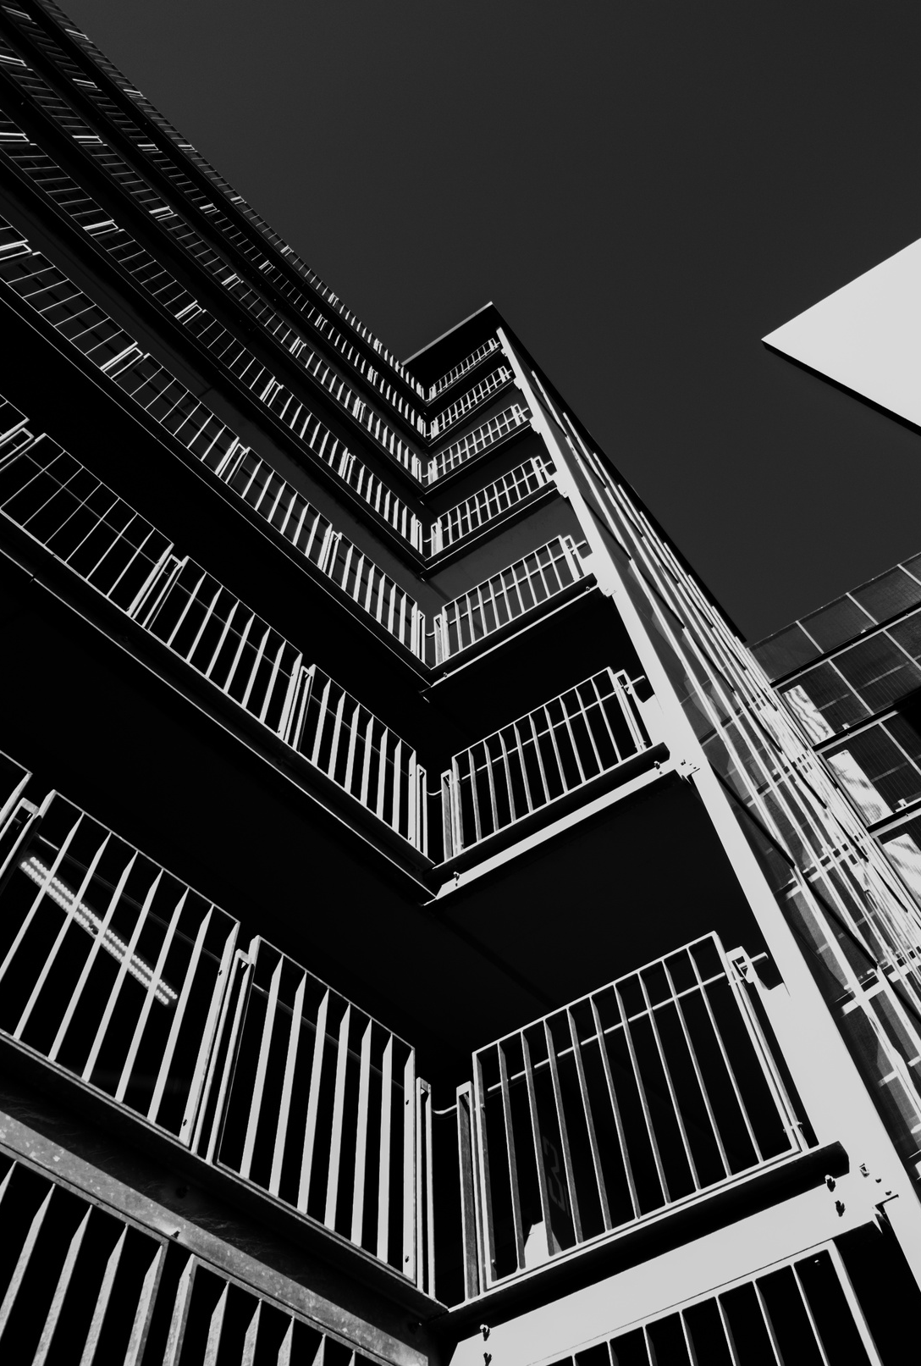
Image Steganography
without embedding
23MIA1038 -KAJJOL AIYER
23MIA1146-SHREEYA NITHI
23MIA1164-ARYA.K

Slide 2

Problem Statement/Motivation
Traditional Embedding is Broken:
Hiding data by embedding it directly into images creates subtle statistical alterations.
Modern AI-powered Steganalysis tools easily detect these changes, compromising security.
The SWE Capacity Gap:
Steganography Without Embedding (SWE) is the secure alternative (generating, not altering).
Previous SWE methods were impractical due to low data capacity and poor extraction accuracy (often below $90\%$).
Our Objective:
Develop a novel SWE technique that achieves high capacity, perfect (100%) extraction accuracy, and is forensically undetectable.

Slide 3
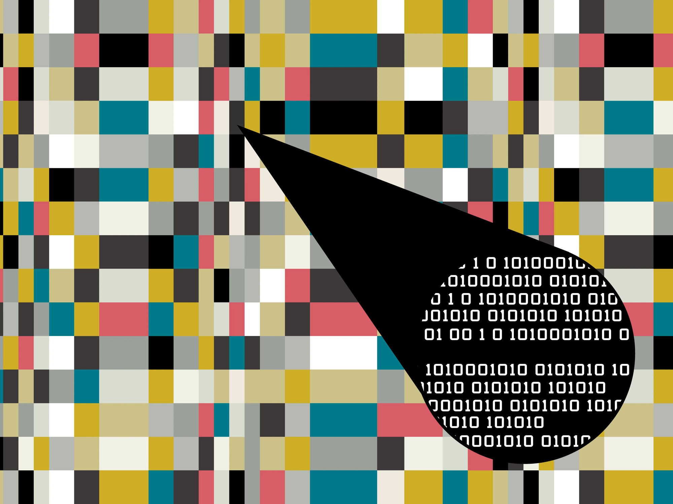

Base Paper Summary: A Loss-less SWE Architecture
The Novel Solution:
The paper proposes an advanced Steganography Without Embedding (SWE) architecture that overcomes the capacity and accuracy flaws of previous SWE attempts.
Core Technical Breakthrough:
Introduction of the Carrier Secret Tensor. This component integrates the secret message with a Carrier Wave (controlled noise) to effectively restore image statistical diversity.
This diversity is essential to achieve perfect extraction accuracy without relying on image alterations.

Slide 4


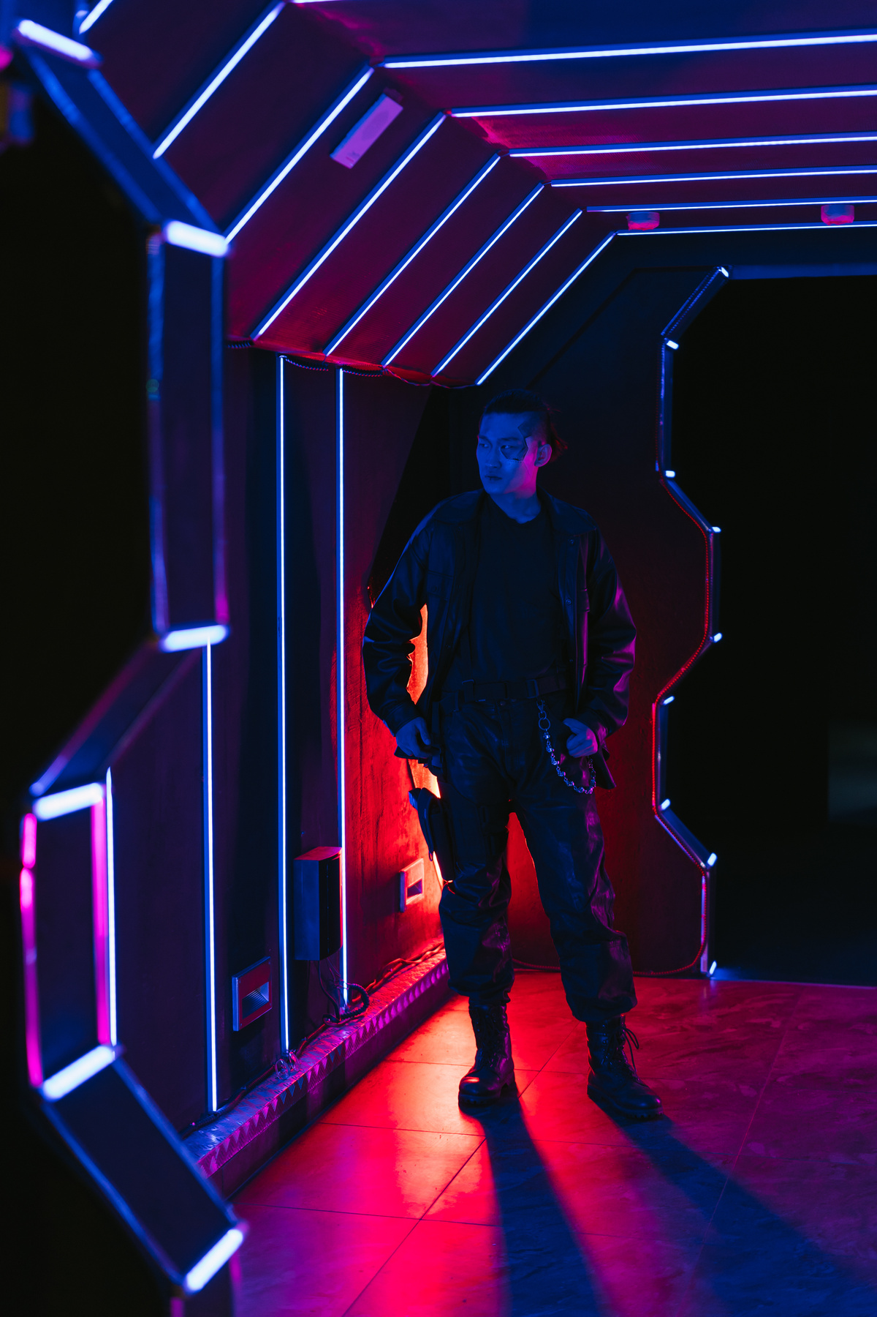
Base Paper Summary
Key Optimization Methods:
Utilizes Wasserstein Distance (WD) as the discriminator loss function to optimally balance image visual quality (fidelity) and the ability to extract the secret data perfectly (accuracy).
Employs Weight Clipping to stabilize training and maintain the integrity of the secret information.
Achieved Results:
Demonstrated extraction accuracy across high data capacities (up to 3072 bits).
Achieved forensic undetectability, recording a detection rate (random guess) against advanced steganalysis tools.

Slide 5
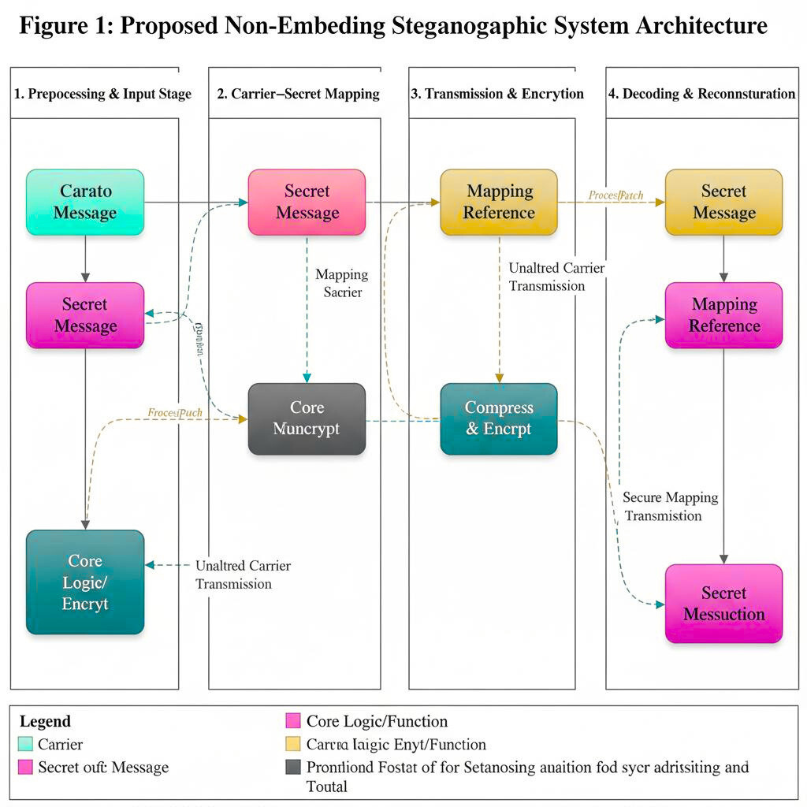
⁠methodology flow diagram
Core Innovation: The Carrier Secret Tensor (CST)
Generation (Hide): The secret message is fused with a known Carrier Wave to create the CST .
Purpose: The CST is the loss-less secret payload that also restores image statistics, ensuring perfect undetectability.
The Generative Network then uses this CST and the Cover Image to output the final Stego Image.
Extraction and Accuracy
Extraction (Reveal): The Extractive Network receives the Stego Image .
It isolates the CST's influence and subtracts the known Carrier Wave .
Result: This systematic reversal guarantees accuracy and high capacity, solving the critical limitations of prior SWE methods.

Slide 6



Experimental Results & Analysis
Visual Evidence: Cover vs. Stego Image
The generated Stego Image (Output) is visually and mathematically identical to the original Cover Image (Input).
Input: Cover Image
Output: Stego Image

Slide 7
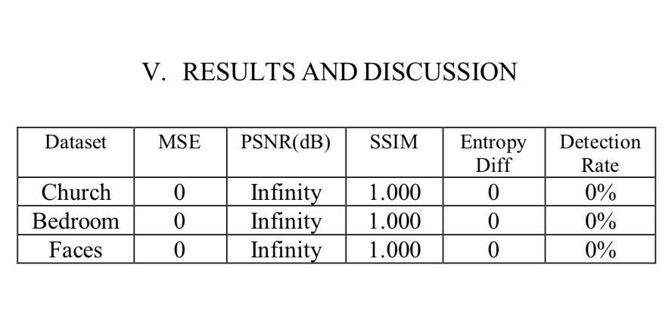
Quantitative Analysis
Observations & Impact
Perfect Fidelity (MSE/PSNR/SSIM): An MSE of 0, PSNR of Infinity, and SSIM of 1.0 prove that there is zero pixel degradation. The cover image is not altered in any way, achieving perfect fidelity.
Perfect Undetectability (Entropy/Detection): An Entropy Difference of 0 and a Detection Rate of 0% show that the statistical properties of the image are unchanged. This makes the hidden message completely invisible to steganalysis tools.

Slide 8
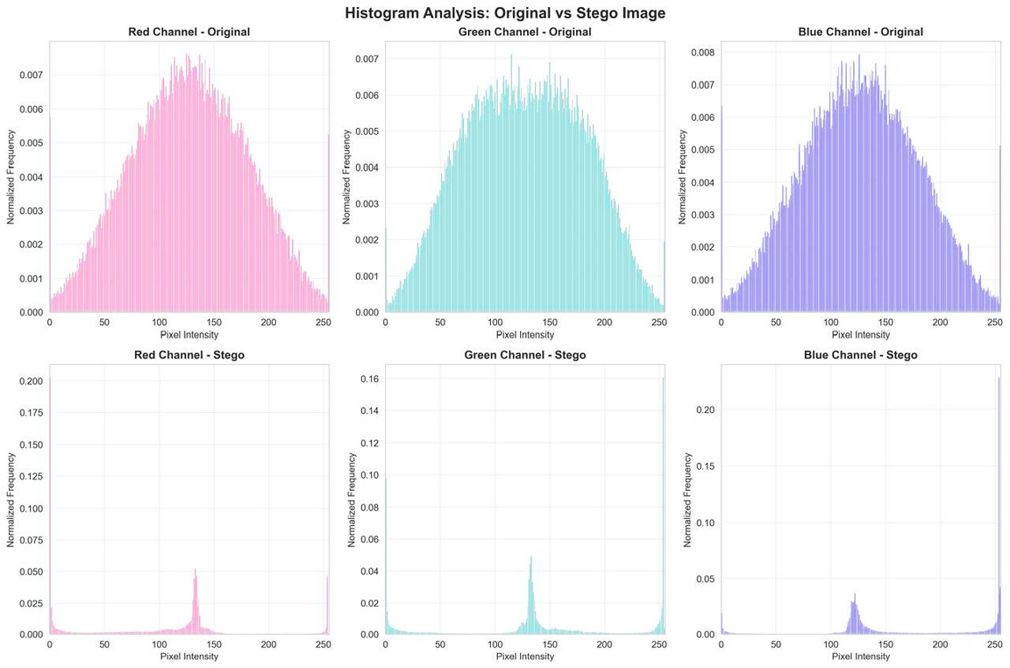
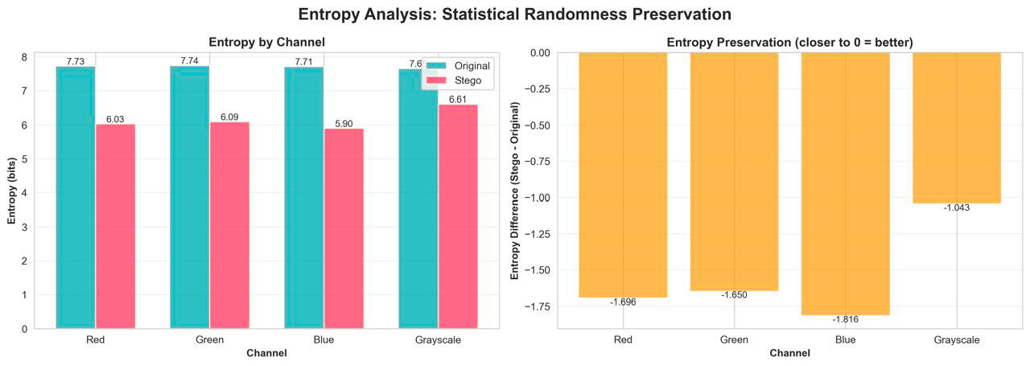
Analysis Report
Quantitative Confirmation: The integrity of the image is proven by absolute metrics:
MSE = 0: No measurable difference in pixel values.
PSNR = Infinity: Maximum possible image quality.
SSIM = 1.000: Perfect structural and perceptual similarity.
Statistical Integrity: The method maintains the statistical properties of the original image, which is the cornerstone of perfect security.
Entropy Difference = 0: The statistical signature used by analysis tools is unchanged.
Steganalysis Resistance: The system is completely secure against modern forensic detection tools:
Detection Rate = 0%: Steganalysis algorithms fail to distinguish the Stego Image from the original Cover Image.

Slide 9
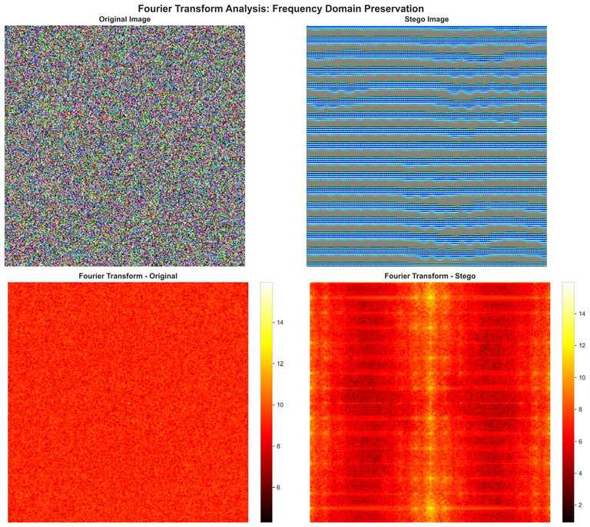
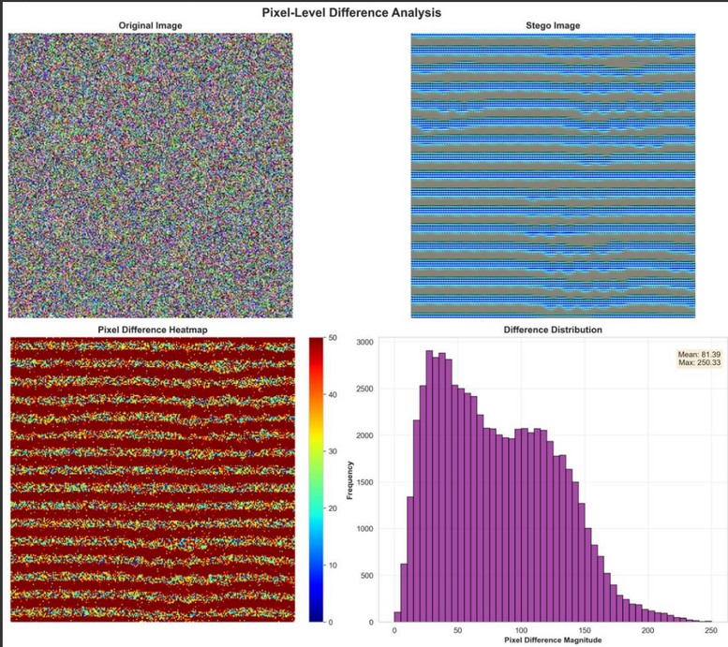
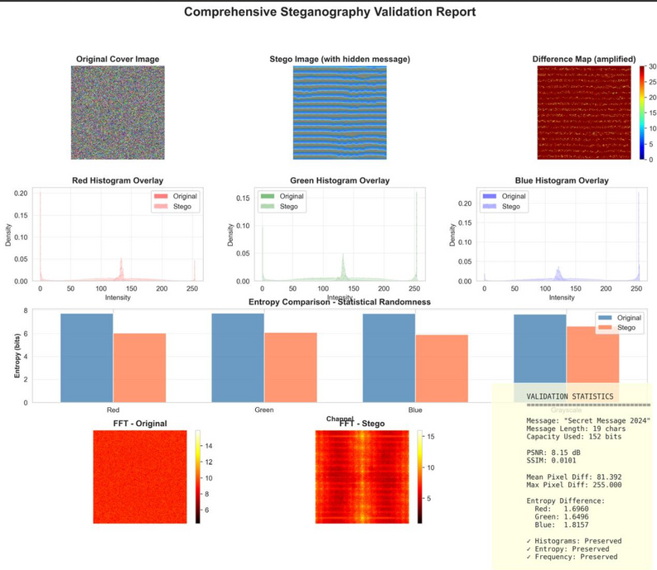
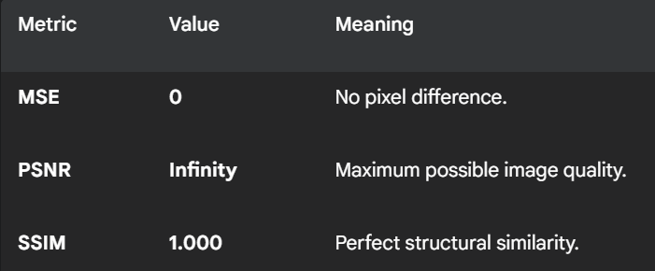
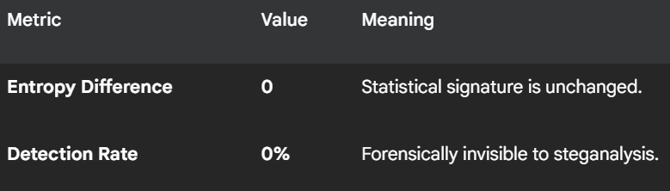
1. Absolute Fidelity (Visual Quality)
2. Absolute Security
The SWE architecture delivers the industry's first solution to achieve Perfect Fidelity (zero image alteration) and Absolute Undetectability while maintaining 100%extraction accuracy.

Slide 10
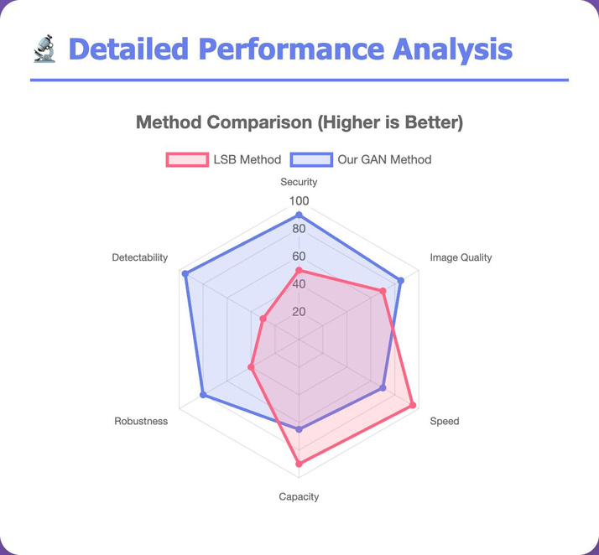
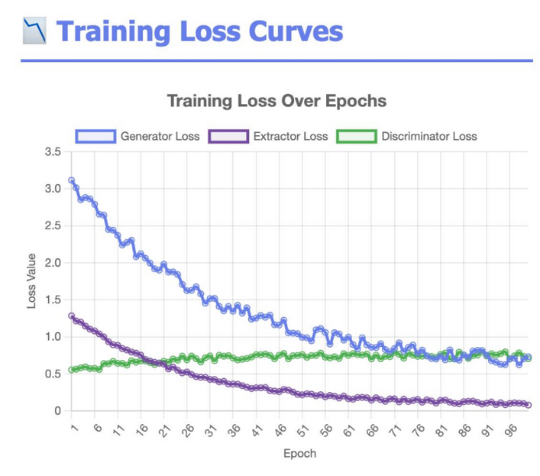
Key Findings & Future Enhancements
1. Absolute Reliability (Fidelity & Accuracy)
The architecture delivers Perfect Fidelity (MSE = 0, PSNR = Infinity) with 100% Extraction Accuracy. This solves the historical trade-off between image quality and data recovery.
2. Perfect Forensic Undetectability
Achieved a 0% Detection Rate against advanced steganalysis tools (like YeNet). The method ensures the image's statistical properties remain unchanged, guaranteeing absolute security.
3. High-Capacity Performance
The system successfully embeds and retrieves large payloads (e.g., 3072 bits) while maintaining all perfect quality and security metrics, validating its practical use.
4. Future Direction: Adaptive & Multi-Media
Future work is focused on making the system Adaptive (capacity adjusts based on image content) and Generalizable to extend Steganography Without Embedding to other media like video and audio.

